Slide 1
LEDNip 0.1 commissioning
20181209

Slide 2
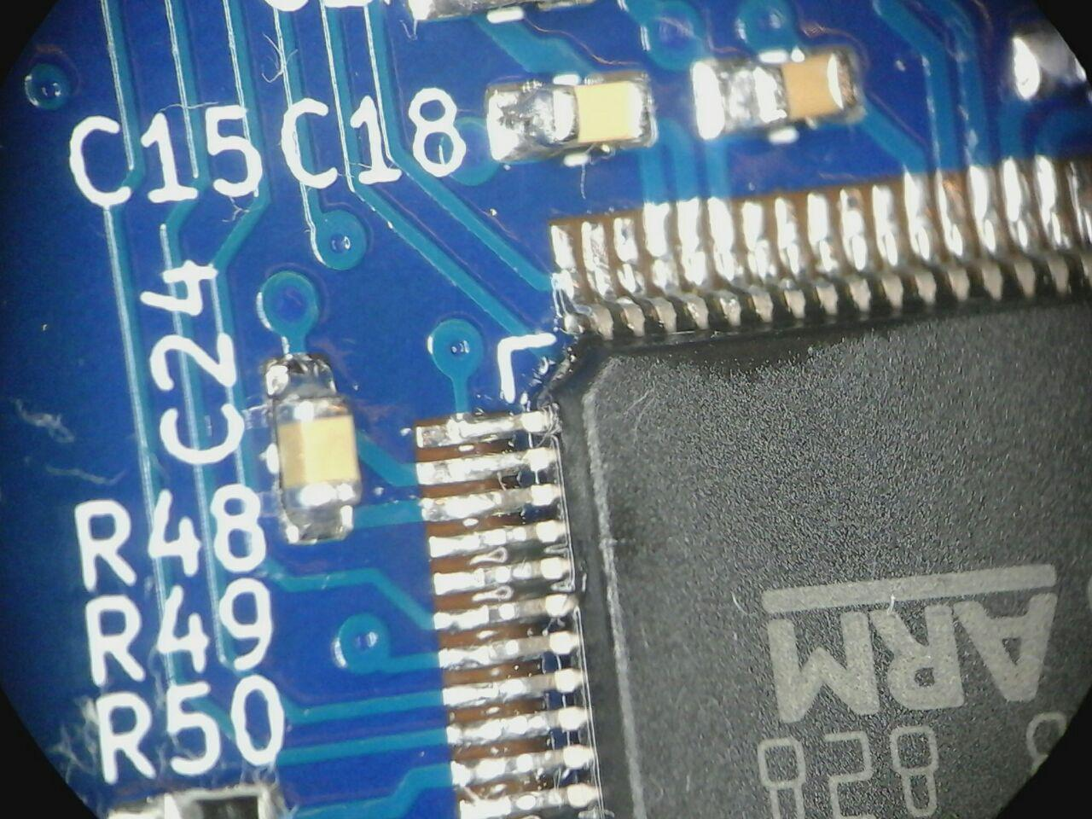
visual inspection
prototype PCB, initial attempt to use lead-free solder paste (partial success)
SMD assembly finalized by hand soldering
additional flux paste used
manual cleaning with CRC LR
initial inspection of solder joints OK
additional JST PH connectors soldered
3.3V rail driven by lab power supply:
solid short
voltages across bypass caps:
lowest on C24

Slide 3
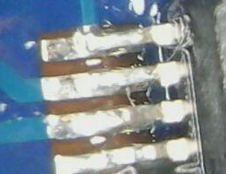
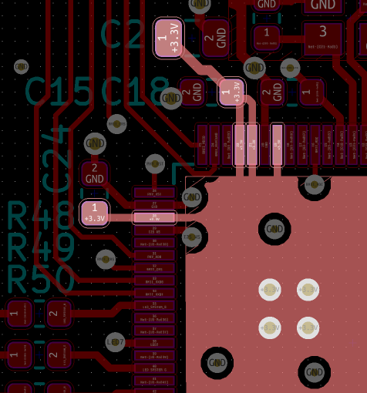
visual inspection
short circuit identified as a 30-50 µm dia. metallic particle stuck to the heel fillets of the
0.5mm pitch TQFP (solder tip / brass sponge contamination?)

Slide 4
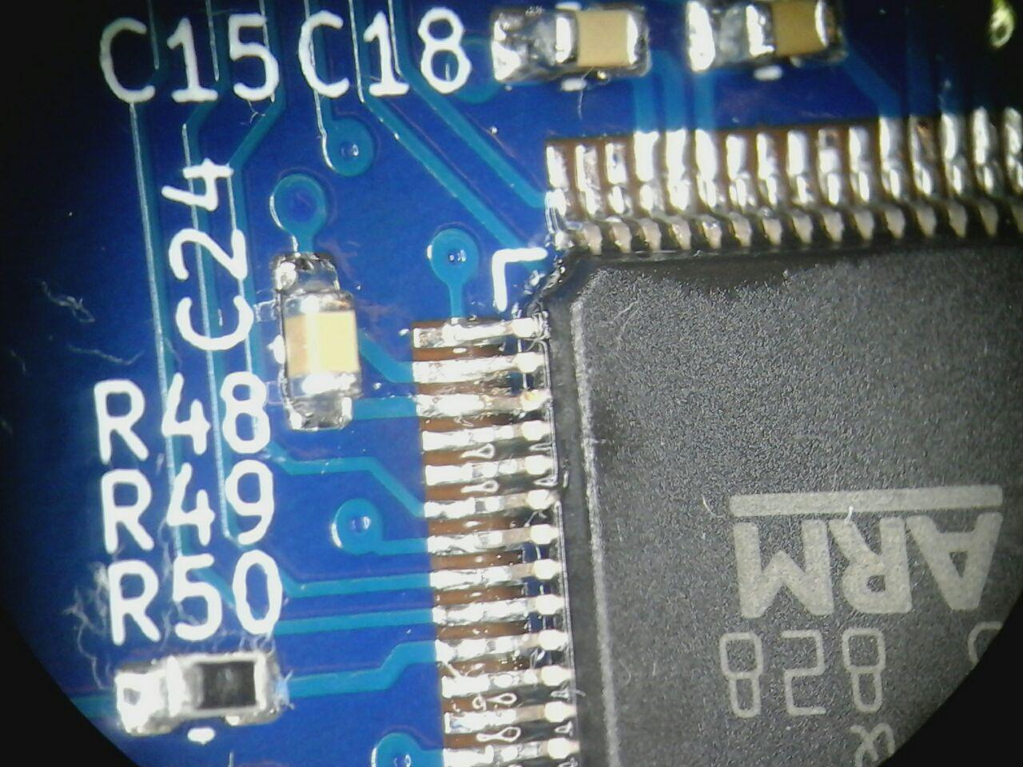
visual inspection
short circuit removed with scalpel
board powers up, 17 mA @ 3.3 V
reference board w/o µC: 13 mA
seems plausible
board deemed acceptable for
subsequent THT assembly
short circuit resolved with scalpel
(see picture to the right)

Slide 5
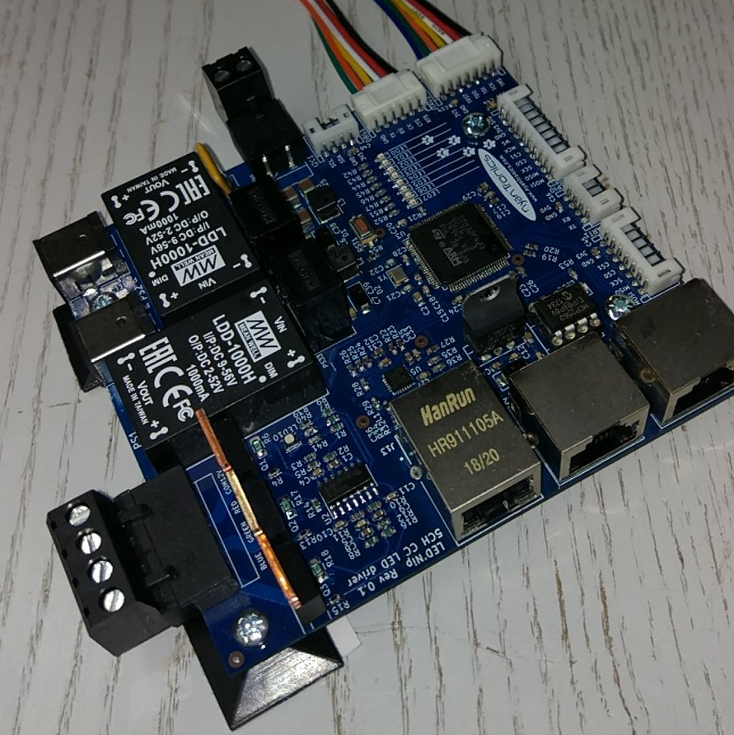
THT assembly
board fully populated (see right)
no footprint mismatches
all parts have proper footprints except
for the 2.0 mm jumper (CAN term)
which was intended to be 2.54 mm.
Resolve by buying 2.0mm pin headers
and jumpers (no big deal)
no problems running the PH
connectors at 1A for some time
Lessons learnt: soldering iron cannot
transfer enough heat to vias w/o
thermals and too small restring.
Further complicated by power planes.
Next time: use offset pads,
larger restring, thermals
for all signals and generally @ < 1.0A

Slide 6
power-up
verify MeanWell LDD-1000H pull-up voltage
reverse polarity protection diodes across DCDC modules and 5V regulator:
* backfeeds 12V rail with ~2.6V
* drives 5V LDO (no output produced, see next slide)
* backfeeds 24V rail with ~1.9V
3.3V rail: tested
5V rail ? todo: tie 5V and 12V together, ramp up to 5.0V, check for excessive current > 50 mA
12V rail ? todo: ramp-up with current limit, check 3.3V and 5V in spec
24V rail ? todo: ramp up with current limit, check 12V in spec

Slide 7
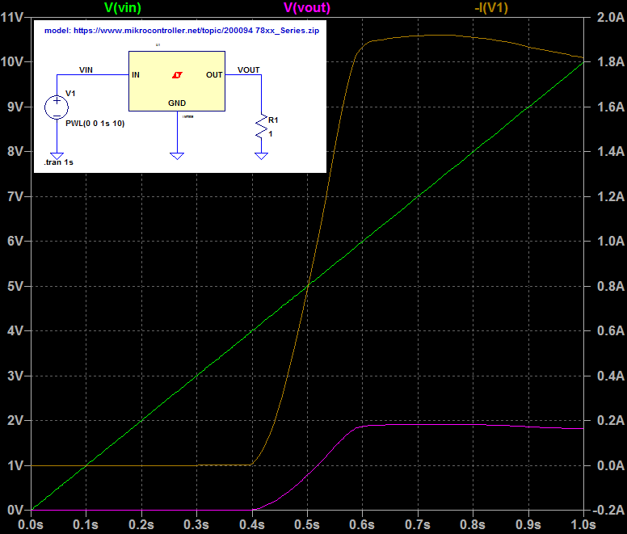
power-up
simulated 1R load:
excessive current draw starts
at 4.0V input and quickly rises
above 100mA.
Pass/fail?
Try to get to 5V with 50mA limit.

Slide 8
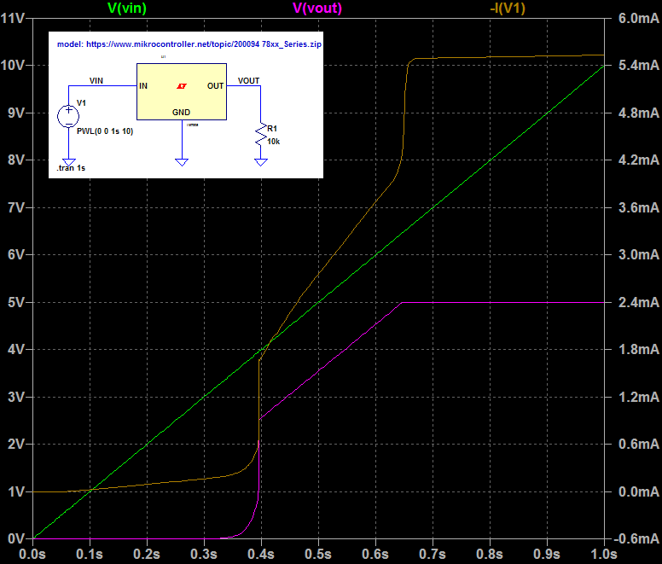
power-up
7805 ramp-up behaviour does not
seem to be spec’ed in datasheets.
behaviour when tested
via 12V rail ramp only:
2.6V input: no output
(3.3V backfeed voltage)
3.5-4V input: output should ramp.
if 5V rail does not rise /
excessive current draw
> 20mA: investigate 5V

Slide 9
tbd

